Slide 1
Dr. Yifeng Zhu Electrical and Computer Engineering University of Maine
Embedded Systems with ARM Cortex-M Microcontrollers in Assembly Language and C
Chapter 24
Digital Signal Processing
Spring 2020

Slide 2
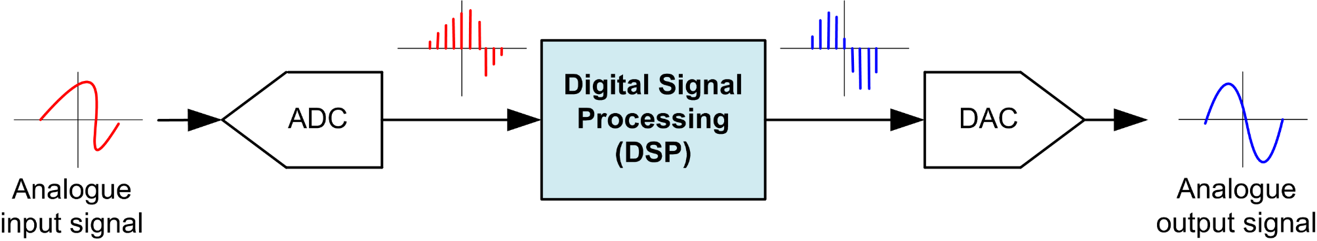
Common Diagram of DSP systems
Quantize analog input signal

Slide 3
Fixed-point vs Floating-point DSP
Floating-point DSP uses FPU
Suitable for applications with wide data range
Easy to program
High hardware cost
Not energy efficient
Fixed-point DSP uses SIMD DSP coprocessor
Suitable for applications with known data range
Difficult to program
Low hardware cost
Very energy efficient

Slide 4
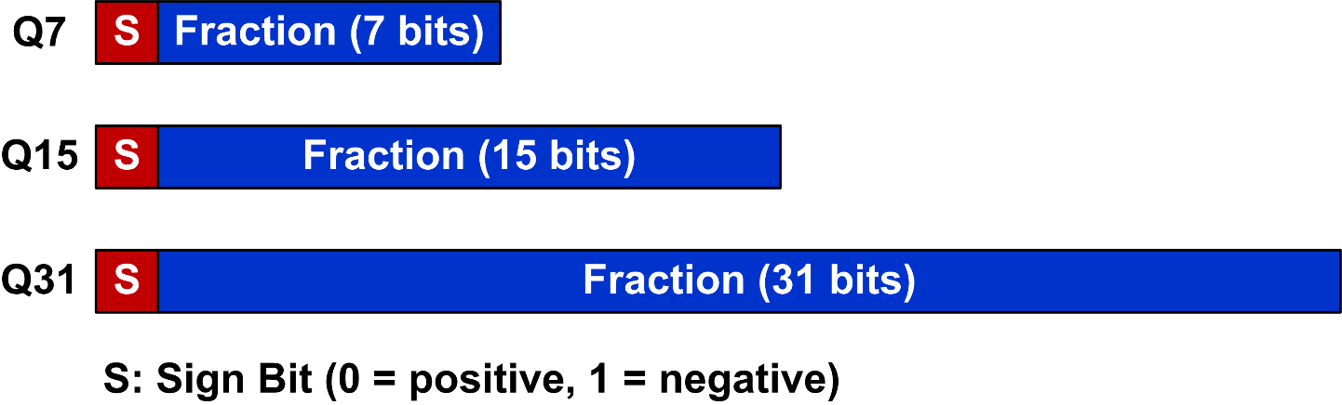
Fixed-point numbers (Review)
Signed fixed-point format: Qn
n is the number of fraction bits
Two’s complement with n+1 bits
Data range: [-1, 1- 2⁻⁷], i.e. [-1, 0.9921875]
Data range: [-1, 1- 2⁻¹⁵], i.e. [-1, 0.999969482421875]
Data range: [-1, 1- 2⁻³¹]
i.e. [-1, 0.999999999534339]

Slide 5
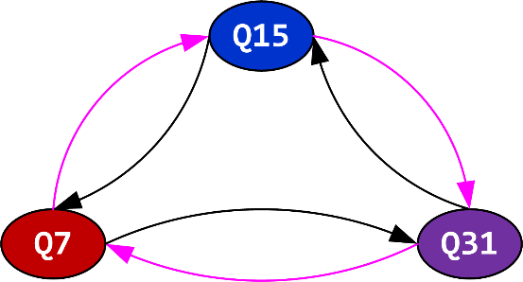
Conversion between Q7, Q15, and Q31

Slide 6
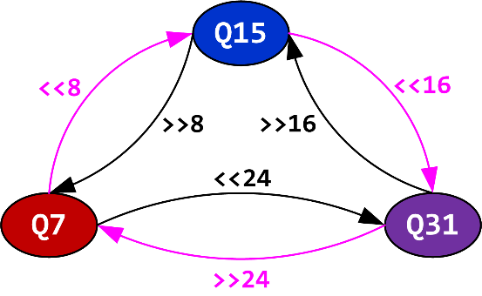
Conversion between Q7, Q15, and Q31

Slide 7
Saturation
When a result of an arithmetic operation is larger than the maximum representable number, overflow occurs.
When a result is smaller than the minimum representable number, underflow occurs.
In ARM technical documents, underflow is often called as overflow.
Q16 fixed-point numbers
Program treats them as signed integers

Slide 8
Saturation
Without saturation, outputs are wrapped-around.
The least-significant bits are truncated.
Overflow values are trimmed to very small values, and
Underflow values are wrapped around to very high values

Slide 9
Saturation
Saturated outputs
Saturation clamps the result to the max or min limit of the representable range

Slide 10
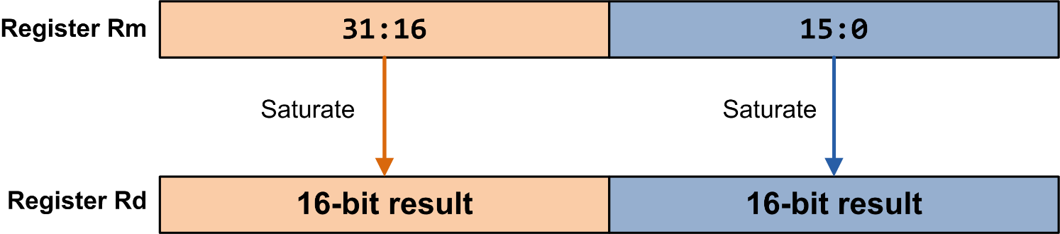
Saturation Instructions
SSAT16 Rd,#imm4,Rm | Signed saturate two signed 16-bit values #imm4 =saturation bit position, -2^{imm4 - 1} ≤ x ≤ 2^{imm4 - 1} -1
USAT16 Rd,#imm4,Rm | Unsigned saturate two unsigned 16-bit values #imm4 = saturation bit position, 0 ≤ x ≤ 2^{imm4} - 1

Slide 11
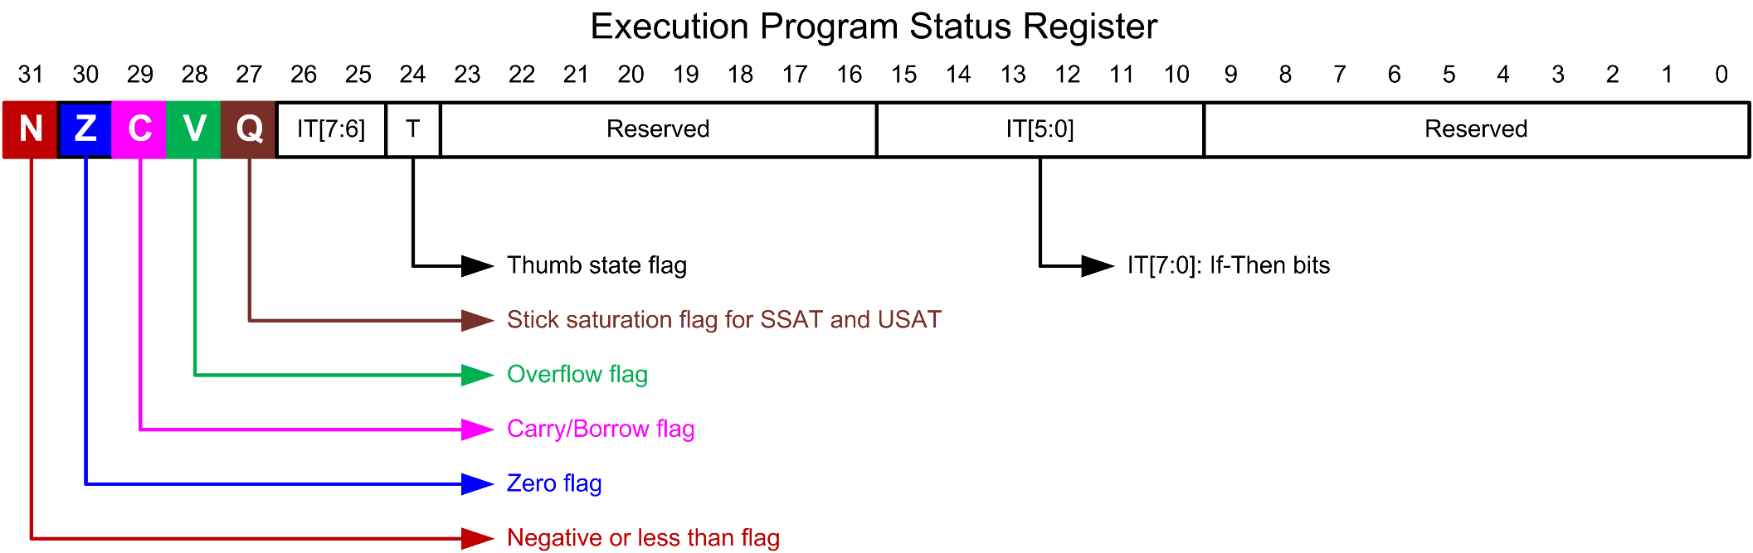
Q flag
Read Q flag | Clear Q flag
MRS r0, APSR ; Z is 1 if Q is 0 TST r0, #(1<<27) | MRS r0, APSR ; Read APSR BIC r0, r0, #(1<<27) ; Clear Q flag MSR APSR_nzcvq, r0 ; Write APSR

Slide 12
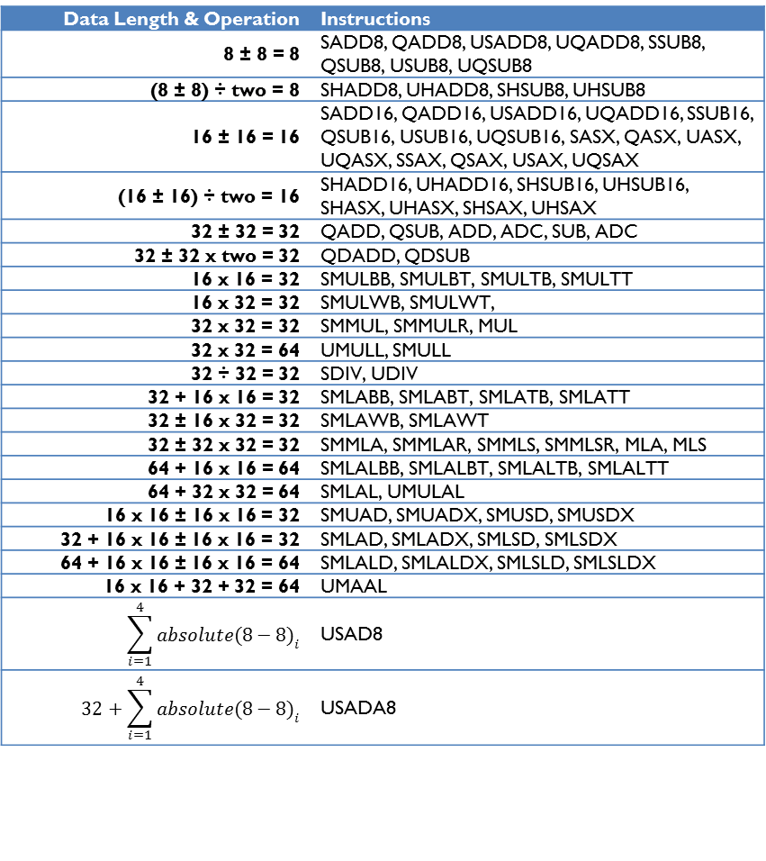
Arithmetic Instructions
Data Length & Operation | Instructions
8 ± 8 = 8 | SADD8, QADD8, USADD8, UQADD8, SSUB8, QSUB8, USUB8, UQSUB8
(8 ± 8) ÷ two = 8 | SHADD8, UHADD8, SHSUB8, UHSUB8
16 ± 16 = 16 | SADD16, QADD16, USADD16, UQADD16, SSUB16, QSUB16, USUB16, UQSUB16, SASX, QASX, UASX, UQASX, SSAX, QSAX, USAX, UQSAX
(16 ± 16) ÷ two = 16 | SHADD16, UHADD16, SHSUB16, UHSUB16, SHASX, UHASX, SHSAX, UHSAX
32 ± 32 = 32 | QADD, QSUB, ADD, ADC, SUB, ADC
32 ± 32 x two = 32 | QDADD, QDSUB
16 x 16 = 32 | SMULBB, SMULBT, SMULTB, SMULTT
16 x 32 = 32 | SMULWB, SMULWT,
32 x 32 = 32 | SMMUL, SMMULR, MUL
32 x 32 = 64 | UMULL, SMULL
32 ÷ 32 = 32 | SDIV, UDIV
32 + 16 x 16 = 32 | SMLABB, SMLABT, SMLATB, SMLATT
32 ± 16 x 32 = 32 | SMLAWB, SMLAWT
32 ± 32 x 32 = 32 | SMMLA, SMMLAR, SMMLS, SMMLSR, MLA, MLS
64 + 16 x 16 = 64 | SMLALBB, SMLALBT, SMLALTB, SMLALTT
64 + 32 x 32 = 64 | SMLAL, UMULAL
16 x 16 ± 16 x 16 = 32 | SMUAD, SMUADX, SMUSD, SMUSDX
32 + 16 x 16 ± 16 x 16 = 32 | SMLAD, SMLADX, SMLSD, SMLSDX
64 + 16 x 16 ± 16 x 16 = 64 | SMLALD, SMLALDX, SMLSLD, SMLSLDX
16 x 16 + 32 + 32 = 64 | UMAAL
$$\sum_{i=1}^{4}{{absolute(8−8)}_{i}}$$ | USAD8
$$32+\sum_{i=1}^{4}{{absolute(8−8)}_{i}}$$ | USADA8
SIMD (Single-Instruction Multiple-Data) instructions
leverage data-level parallelism and simultaneously apply the same operation to each member of a set of data.

Slide 13
Parallel Add and Subtract
Prefix/ Postfix | Signed (S) | Signed Saturating (Q) | Signed Halving (SH) | Unsigned (U) | Unsigned Saturating (UQ) | Unsigned Halving (UH)
ADD8 | SADD8 | QADD8 | SHADD8 | UADD8 | UQADD8 | UHADD8
SUB8 | SSUB8 | QSUB8 | SHSUB8 | USUB8 | UQSUB8 | UHSUB8
ADD16 | SADD16 | QADD16 | SHADD16 | UADD16 | UQADD16 | UHADD16
SUB16 | SSUB16 | QSUB16 | SHSUB16 | USUB16 | UQSUB16 | UHSUB16
ASX | SASX | QASX | SHASX | UASX | UQASX | UHASX
SAX | SSAX | QSAX | SHSAX | USAX | UQSAX | UHSAX

Slide 14
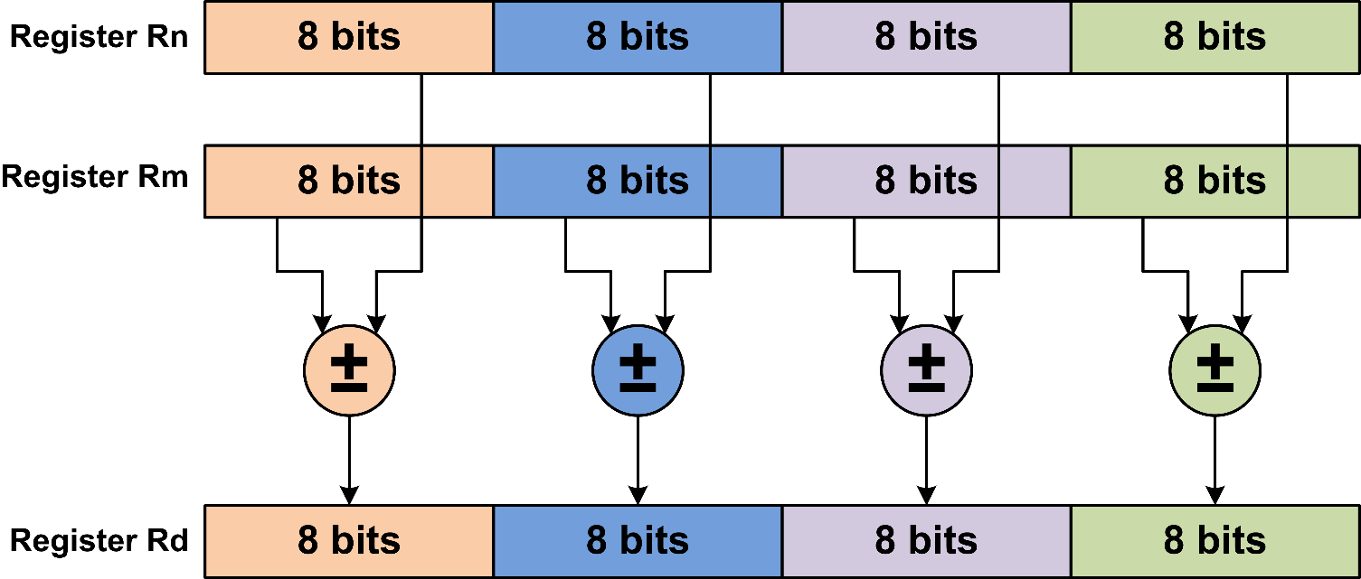
Parallel 8-bit Add and Subtract
SADD8 Rd, Rn, Rm
UADD8 Rd, Rn, Rm
QADD8 Rd, Rn, Rm
UQADD8 Rd, Rn, Rm
SSUB8 Rd, Rn, Rm
USUB8 Rd, Rn, Rm
QSUB8 Rd, Rn, Rm
UQSUB8 Rd, Rn, Rm

Slide 15
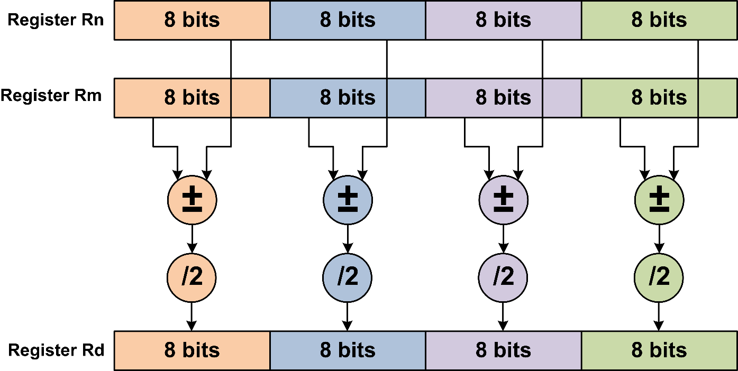
Parallel 8-bit Add/Subtract and Half
SHADD8 Rd,Rn,Rm
UHADD8 Rd,Rn,Rm
SHSUB8 Rd,Rn,Rm
UHSUB8 Rd,Rn,Rm

Slide 16
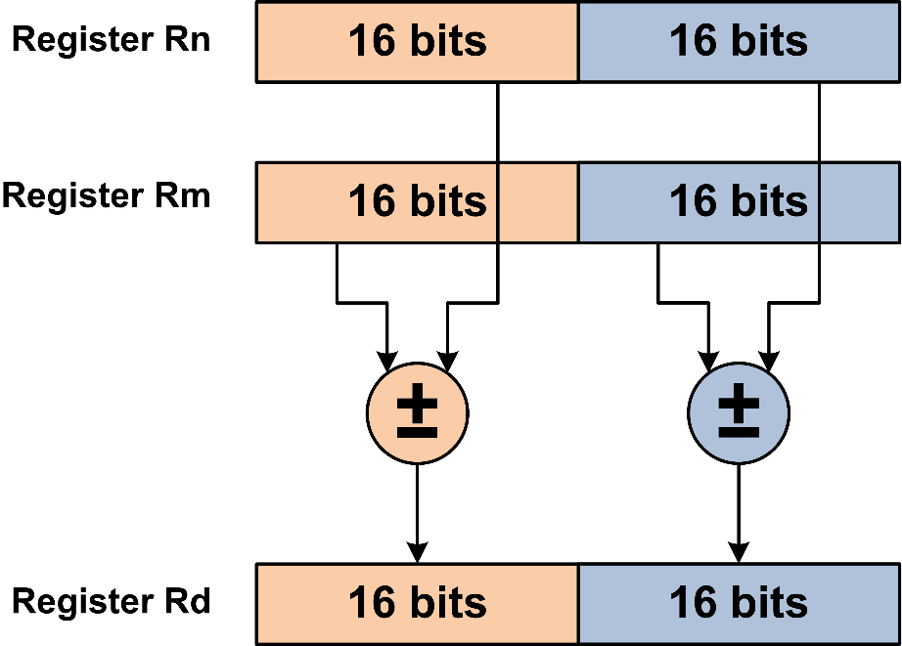
Parallel 8-bit Add and Subtract
SADD16 Rd,Rn,Rm
UADD16 Rd,Rn,Rm
QADD16 Rd,Rn,Rm
UQADD16 Rd,Rn,Rm
SSUB16 Rd,Rn,Rm
USUB16 Rd,Rn,Rm
QSUB16 Rd,Rn,Rm
UQSUB16 Rd,Rn,Rm

Slide 17
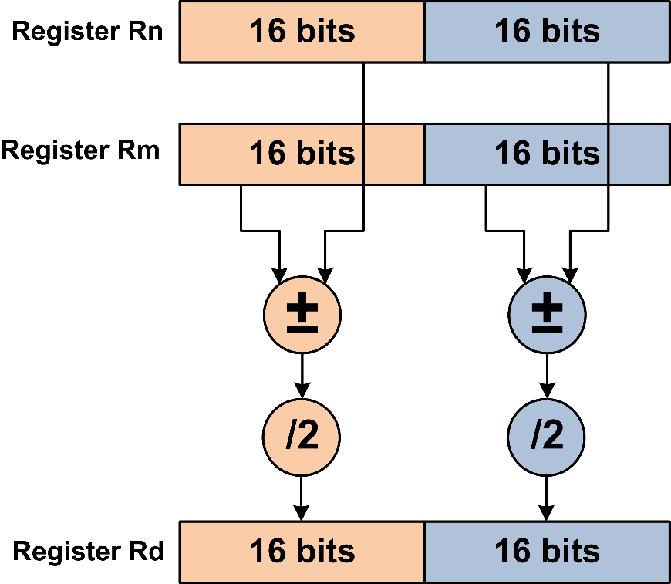
Parallel 8-bit Add/Subtract and Half
SHADD16 Rd,Rn,Rm
UHADD16 Rd,Rn,Rm
SHSUB16 Rd,Rn,Rm
UHSUB16 Rd,Rn,Rm

Slide 18
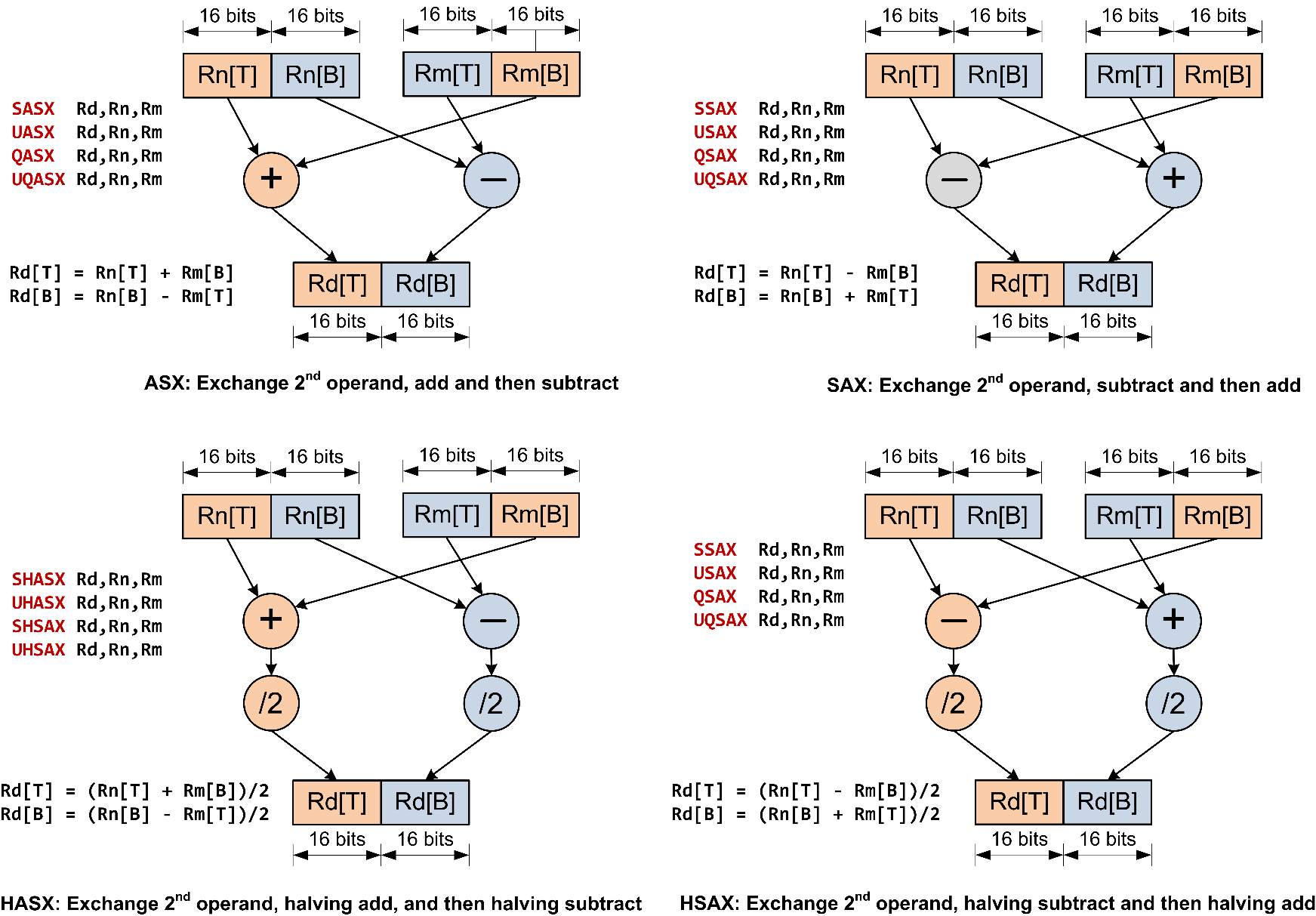
Exchange and Add/Subtract

Slide 19
16-bit and 32-bit Muliplication
Signed halfword multiplication
SMULBB Rd,Rn,Rm | Signed multiply bottom halfwords Rd = Rn[B]*Rm[B]
SMULBT Rd,Rn,Rm | Signed multiply bottom and top halfwords Rd = Rn[B]*Rm[T]
SMULTB Rd,Rn,Rm | Signed multiply top and bottom halfwords Rd = Rn[T]*Rm[B]
SMULTT Rd,Rn,Rm | Signed multiply top halfwords Rd = Rn[T]*Rm[T]
Signed multiplication between halfword and word
SMULWB Rd,Rn,Rm | Signed multiply word by bottom halfword Rd = (Rn*Rm[B])>>16
SMULWT Rd,Rn,Rm | Signed multiply word by top halfword Rd = (Rn*Rm[T])>>16
Signed word multiplication
SMMUL Rd,Rn,Rm | Signed most significant word multiply with truncating Rd = (Rn*Rm)>>32
SMMULR Rd,Rn,Rm | Signed most significant word multiply with rounding to the nearest, Rd = (Rn*Rm)>>32

Slide 20
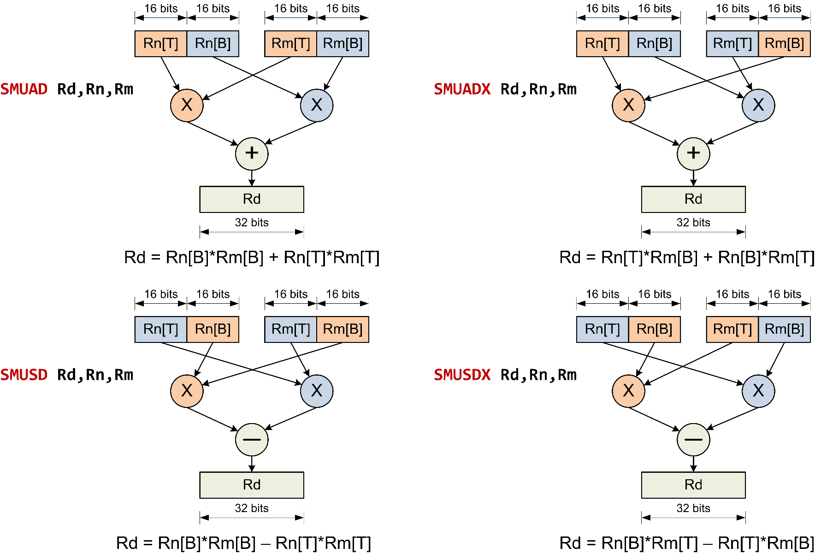
16-bit Multiplication and Add

Slide 21
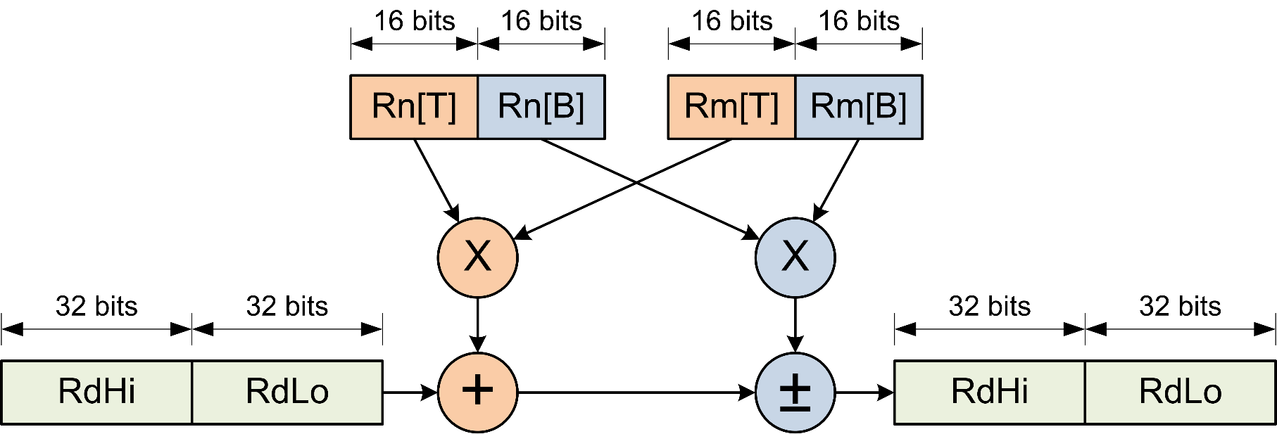
16-bit Multiply and Accumulate with 64-bit Result
RdHi:RdLo = RdHi:RdLo + Rn[T]×Rm[T] ± Rn[B]×Rm[B]
SMLALD RdLo,RdHi,Rn,Rm
SMLSLD RdLo,RdHi,Rn,Rm

Slide 22
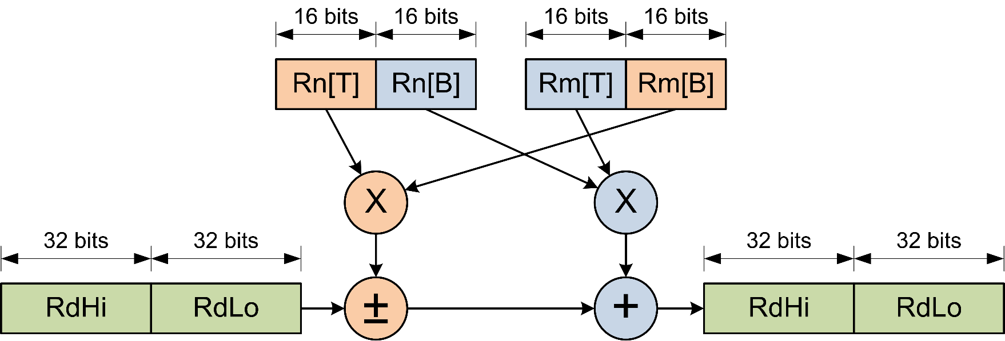
16-bit Multiply and Accumulate with 64-bit Result
RdHi:RdLo = RdHi:RdLo ± Rn[T]×Rm[B] + Rn[B]×Rm[T]
SMLALDX RdLo,RdHi,Rn,Rm
SMLSLDX RdLo,RdHi,Rn,Rm

Slide 23
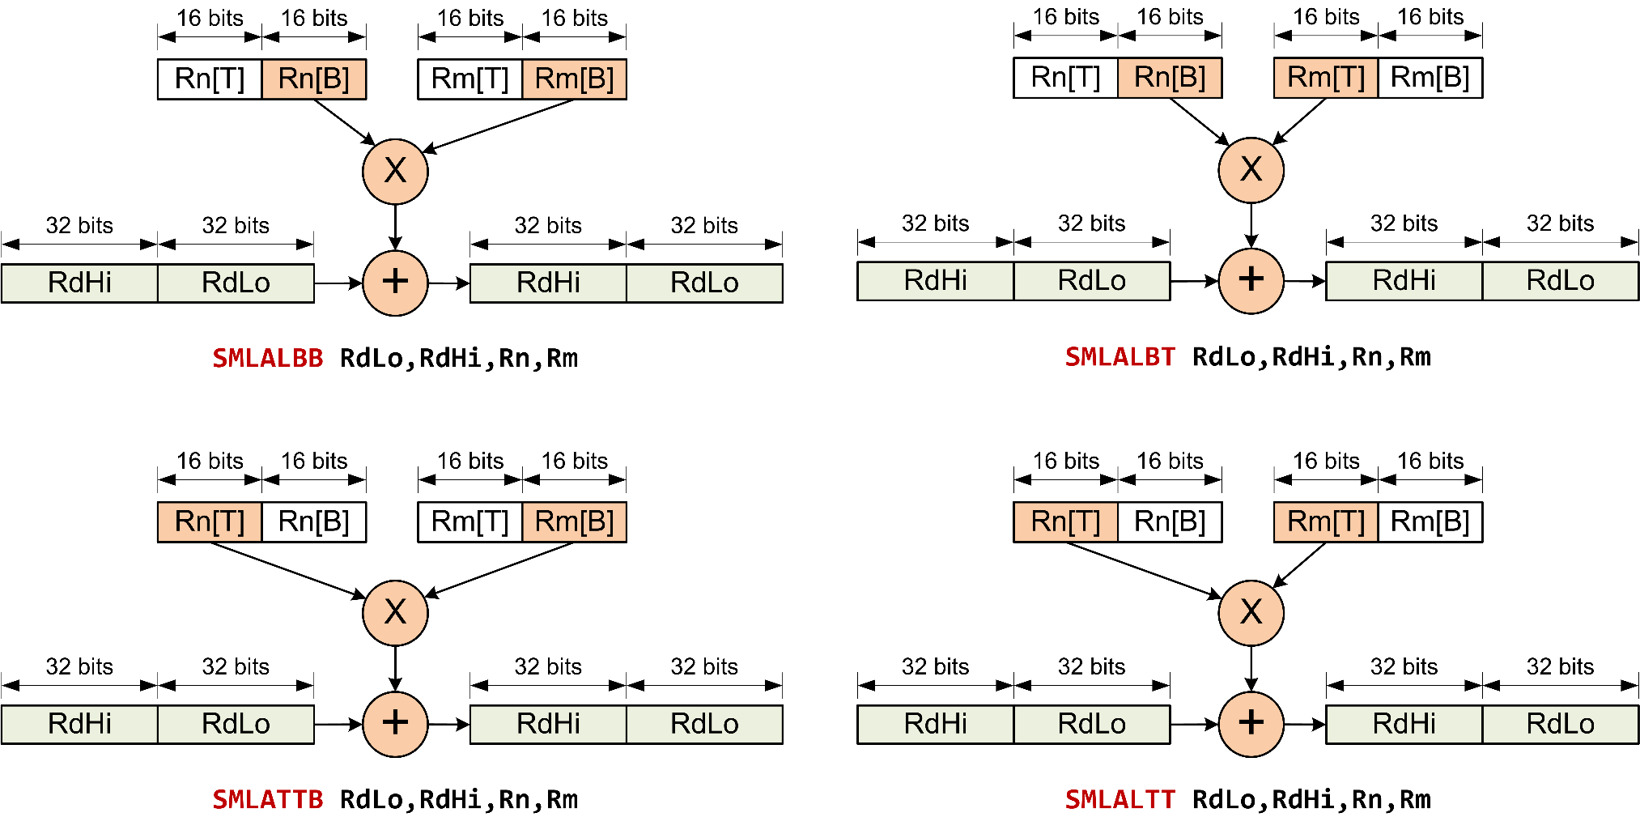
16-bit Multiply and Accumulate with 64-bit Result

Slide 24
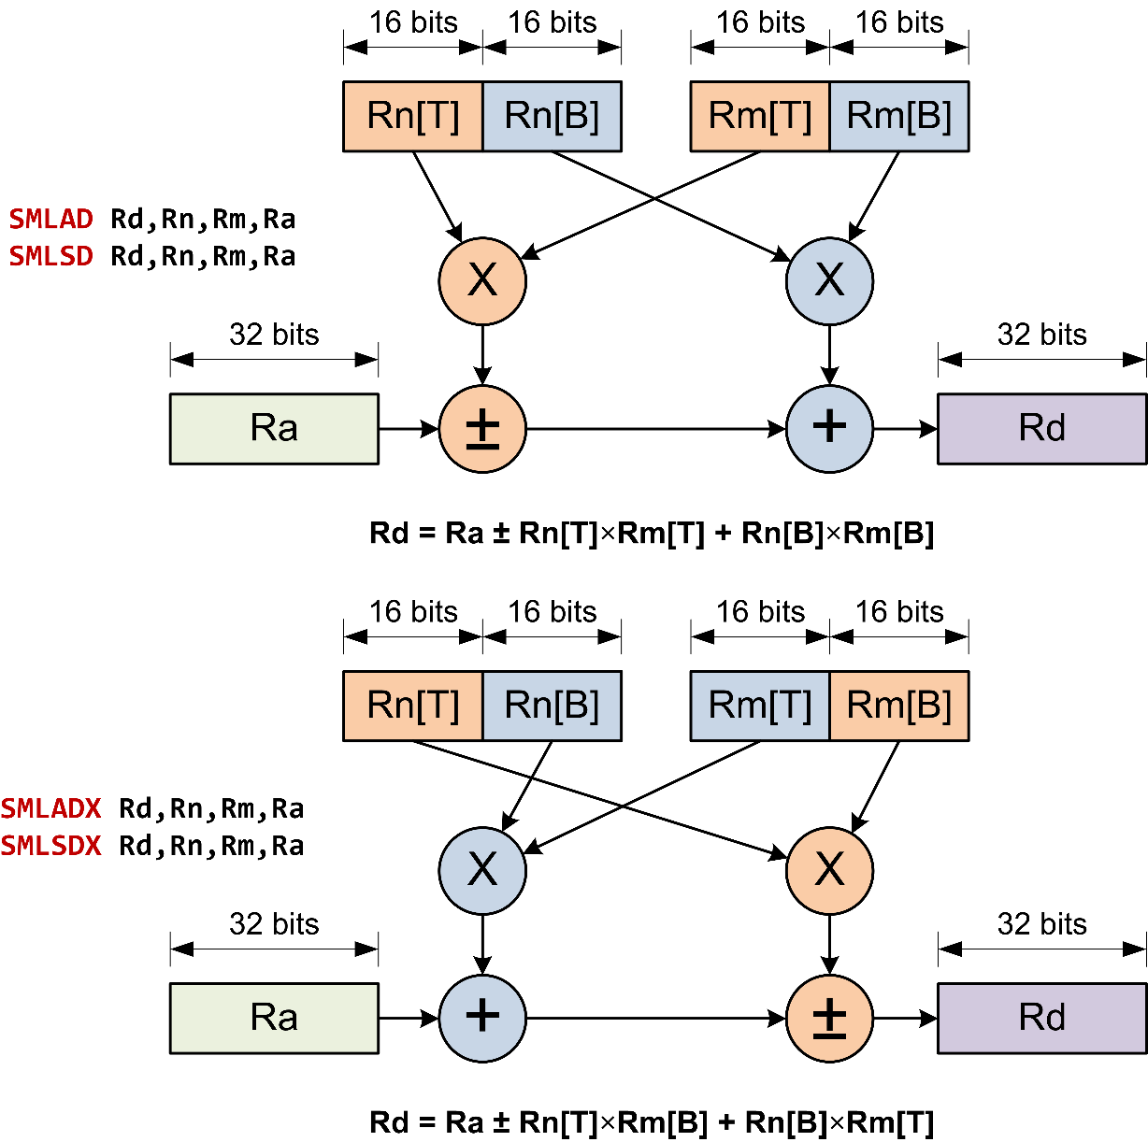
16-bit Multiply and Accumulate with 32-bit Result

Slide 25
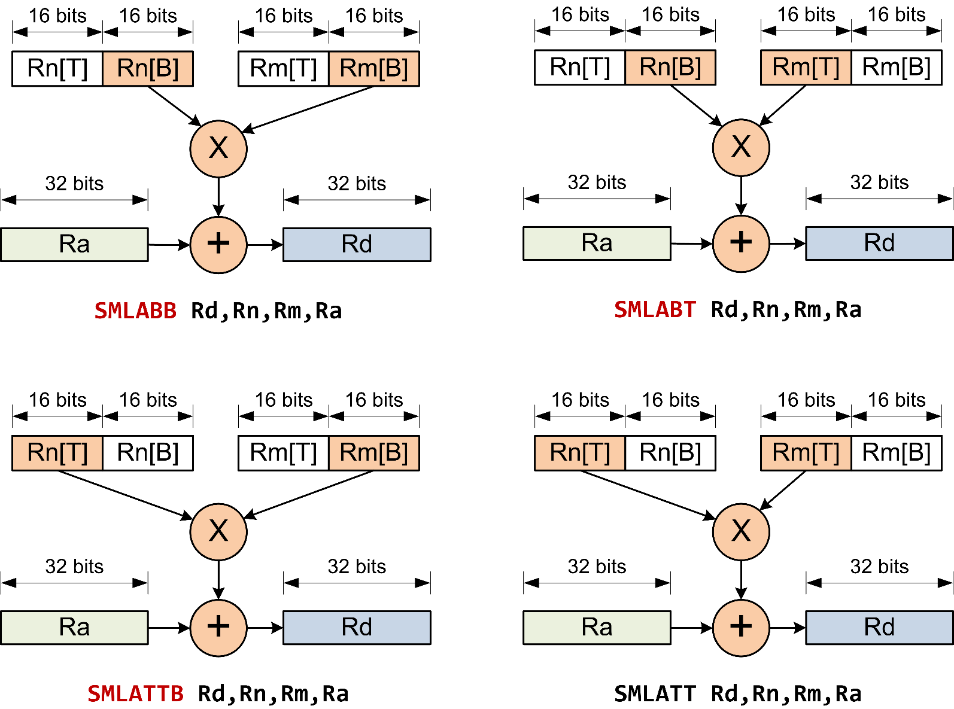
16-bit Multiply and Accumulate with 32-bit Result

Slide 26
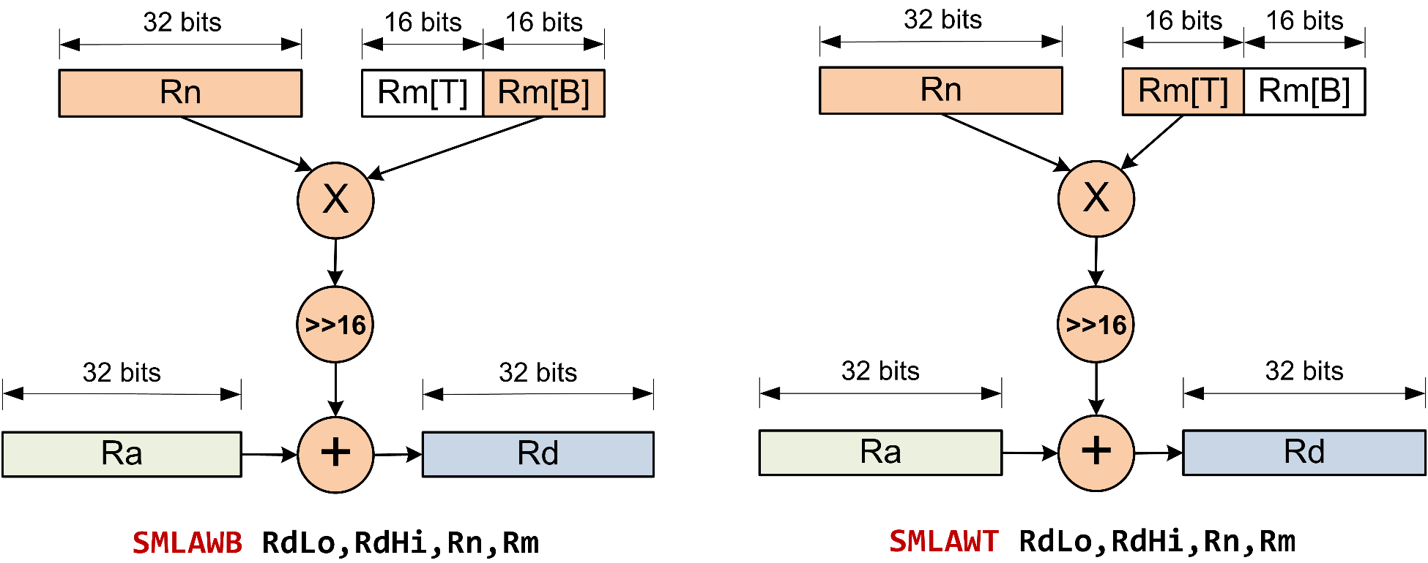
16×32 Multiply and Accumulate with 32-bit Result

Slide 27
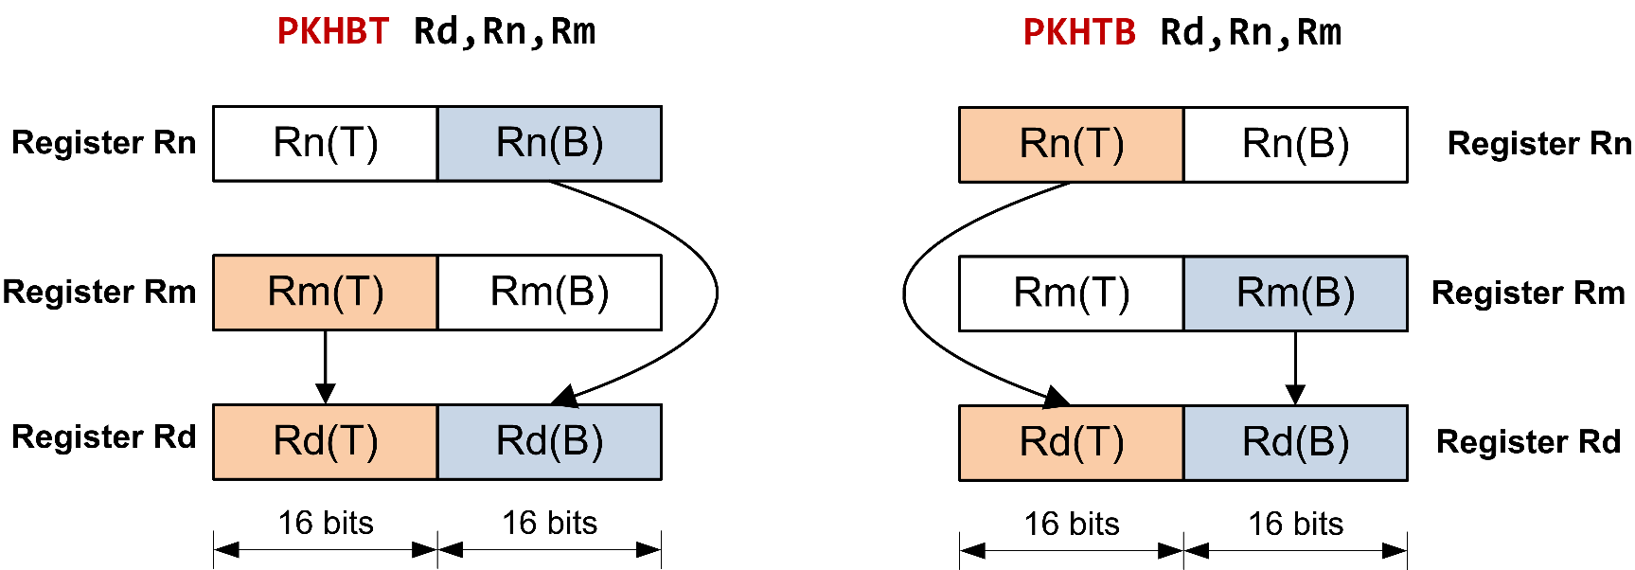
Packing Halfwords into a Word

Slide 28
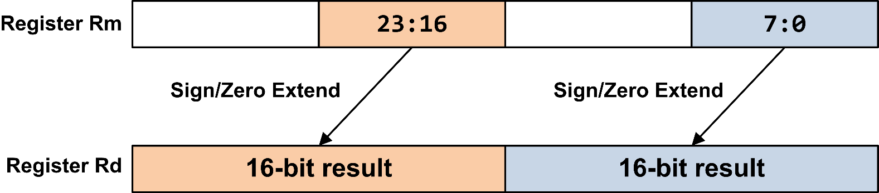
Signed and Unsigned Extension
SXTB16 Rd,Rm {,ROR #n} | Signed extend byte to 16-bit value Rd[T] = sign_extend ((Rm, ROR #)[23:16]) Rd[B] = sign_extend ((Rm, ROR #)[7:0])
UXTB16 Rd,Rm {,ROR #n} | Unsigned extend byte to 16-bit value Rd[T] = zero_extend ((Rm, ROR #)[23:16]) Rd[B] = zero_extend ((Rm, ROR #)[7:0])

Slide 29
GE Flags
 | GE = 1 | GE = 0
SADD8, SADD16 | The corresponding result is greater than or equal to zero. | The corresponding result is smaller than zero.
SSUB8, SSUB16
SASX, SSAX
UADD8 UADD16 | The corresponding result did overflow, generating a carry. | The corresponding result did not overflow.
USUB8 USUB16 | The corresponding result is greater than or equal to zero, meaning borrow did not occur. | The corresponding result is smaller than zero, meaning borrow did occur.
UASX USAX | “A” (Add) sets GE flags in the same way as ADDS sets the C flag. If overflow occurs, corresponding GE flags are set to 1. “S” (Subtract) sets GE flags in the same way as SUBS sets the C flag. If borrow occurs, the corresponding GE flags are set to 0

Slide 30
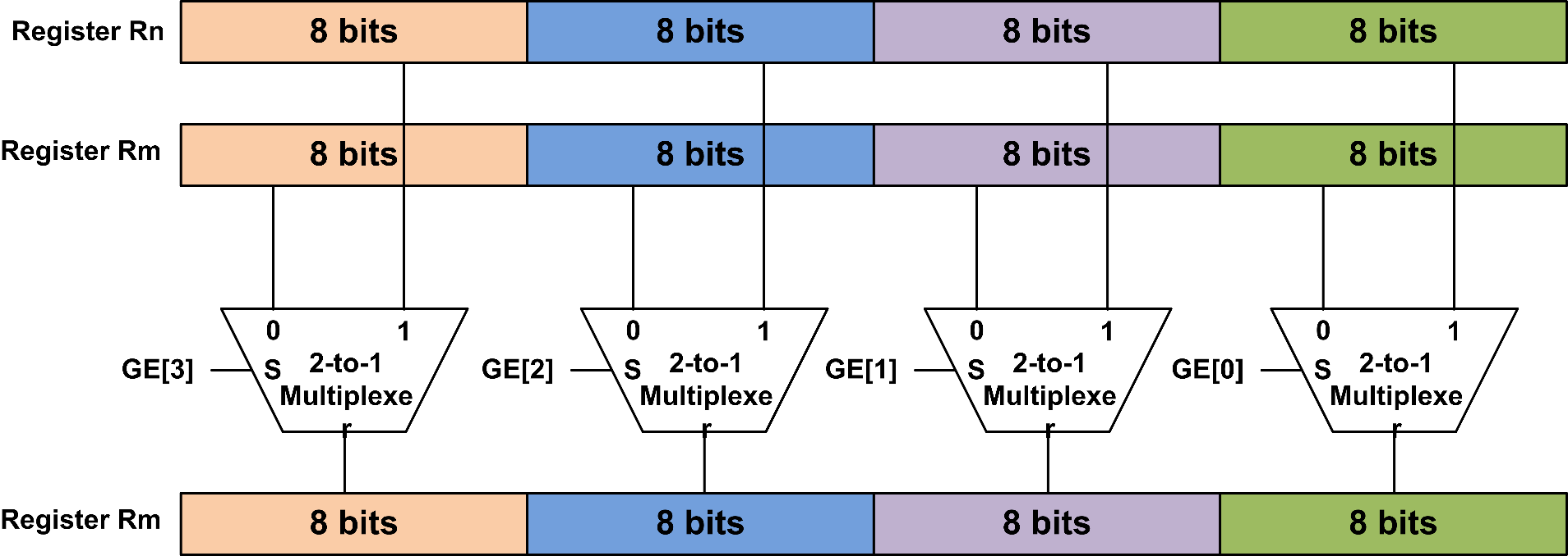
Byte Selection Instruction
SEL Rd,Rn,Rm

Slide 31
Example 1: Vector Negate
vector_negate_Q15 PROC export vector_negate_Q15 ; r0 = pSrc, pointer to source Q15 array ; r1 = pDst, pointer to destination Q15 array ; r2 = # of Q15 values in source array PUSH {r4,r5,lr} MOV r3, #0 MOV r4, #0 ; Initialize loop counter B check loop LDR r5, [r0], #4 ; Load two Q15 values, post-index QSUB16 r5, r3, r5 ; Negate two Q15 values in parallel STR r5, [r1], #4 ; Store two Q15 values, post-index ADDS r4, r4, #2 ; Increase loop counter check CMP r4, r2 ; Compare with array size BLT loop POP {r4,r5,pc} ENDP

Slide 32
Example 2: Vector Mean
vector_mean_Q15 PROC export vector_mean_Q15 ; r0 = pSrc, pointer to source Q15 array ; r1 = # of Q15 values in source array PUSH {r4-r6, lr} MOV r3, #0 ; sum = 0 MOV r6, #0x00010001 ; r3[T] = 1, r3[B] = 1 MOV r4, #0 ; Initialize loop counter B check loop LDR r5, [r0], #4 ; Load four Q15 values, post-index SMLAD r3, r5, r6, r3 ; r3 = 1*r5[T] + 1*r5[B] ADDS r4, r4, #2 ; Increase loop counter check CMP r4, r1 ; Compare with array size BLT loop SDIV r3, r3, r1 MOV r0, r3 ; sum returned in r0 POP {r4-r6, pc} ENDP

Slide 33
Example 3: Vector Absolute
vector_abs_Q15 PROC EXPORT vector_abs_Q15 ; r0 = pSrc, pointer to source Q15 array ; r1 = pDst, pointer to destination Q15 array ; r2 = # of Q15 values in source array PUSH {r4-r8, LR} ; Preserve registers MOV r6, #0 MOV r3, #0 ; Initialize loop counter B check loop LDR r4, [r0], #4 ; Load two Q15 values SSUB16 r5, r4, r6 ; Set GE flags SEL r7, r5, r6 ; Select all positive Q15 based on GE flags SSUB16 r5, r6, r4 ; Negate r4, and set GE flags SEL r8, r5, r6 ; Select all positive Q15 based on GE flags ORR r5, r7, r8 ; Merge two selections STR r5, [r1], #4 ; Store results ADDS r3, r3, #2 ; Increase loop counter check CMP r3, r2 ; Compare with array size BLT loop POP {r4-r8, pc} ENDP

